Slide 1

Automated Invoice Data Extraction and Database Storage Author- Mr Rohit Vasudev Chaudhari
This Photo by Unknown Author is licensed under CC BY-NC-ND

Slide 2

What is pytesseract?
Pytesseract is a Python library that serves as a wrapper for Tesseract OCR (Optical Character Recognition) engine.
OCR is a technology that converts images containing printed or handwritten text into machine-readable text.
Tesseract OCR, developed by Google, is one of the most widely used open-source OCR engines.

Slide 3
Liabraries used for Pytesseract
IMPORT PYTESSERACT
In our Code IMAGE_TO_STRING() is the main function in pytesseract that performs OCR on the given Image and Extracts the text from Image file.
In this we have to give Folder path in which we have stored the Images.

Slide 4
Why we use OS Module?
In Python, the os.path module provides functions for working with file paths in a platform-independent manner
To join multiple path components together into a single path, you can use the os.path.join() function.

Slide 5
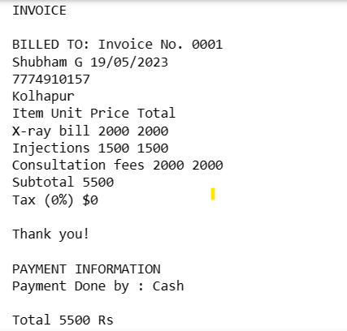
Raw data

Slide 6

Use of Regular Expression..
In our code the extracted text from PYTESSERACT is in row format (That means output contains multiple unwanted data and symbols).
So we need to Filter Out the data that we only need.
So by using this we can achieve what we wanted.

Slide 7
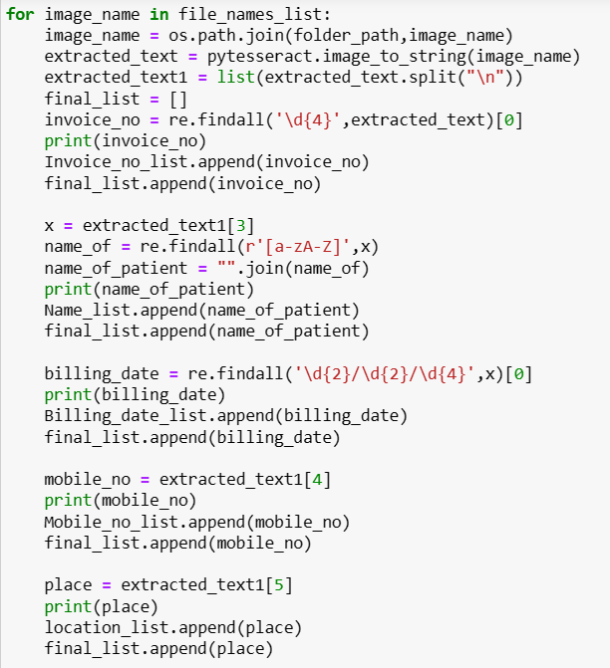
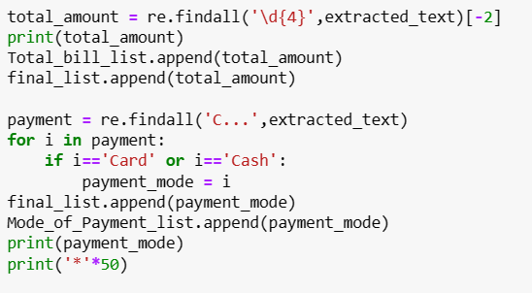
CODE OF REGEX

Slide 8
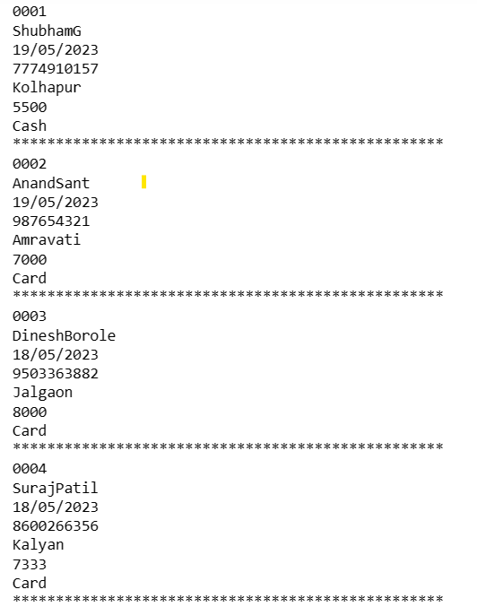
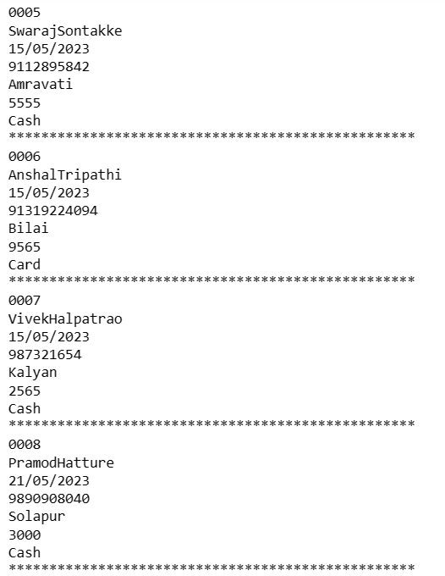
OUTPUT AFTER USING REGEX

Slide 9
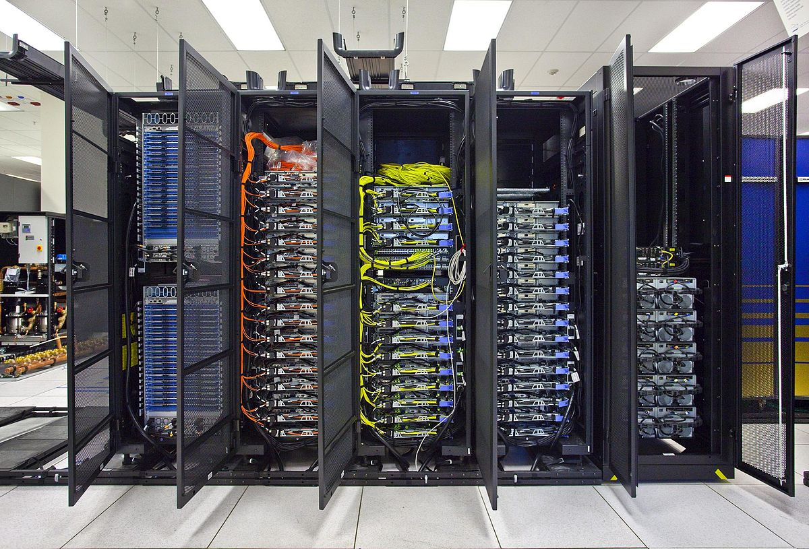
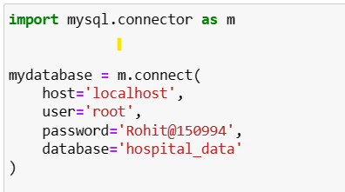
Upload data to database…
mysql.connector is a Python module that provides a standardized way to connect and interact with MySQL databases.
It serves as a driver or connector for MySQL, allowing you to execute SQL queries, manage database connections, and handle result sets.

Slide 10
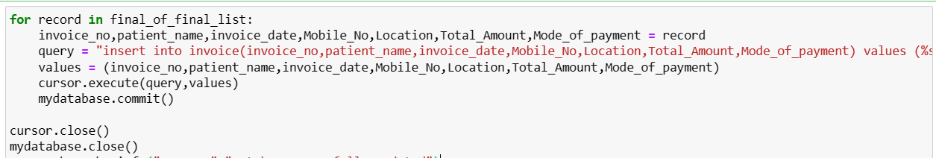
When Connected Succesfully to the Database we have Created a Table INVOICE inside Hospital_Database.
Then by writing INSERT query we have inserted required data in the INVOICE Table.

Slide 11
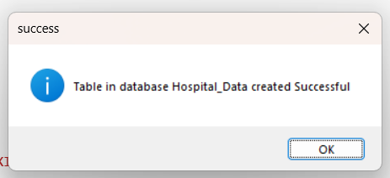
Once the Data Successfully inserted inside table the tkinter message box appears that Shows message that

Slide 12
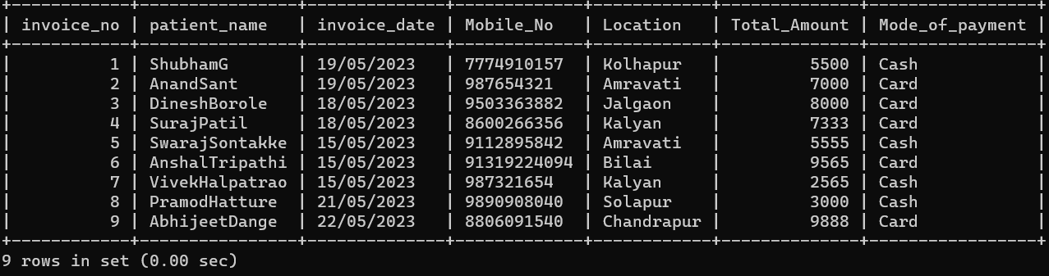
DATA Inside DATABASE

Slide 13
SHOWING DATAFRAME USING PANDAS…
Pandas is a popular open-source Python library that provides high-performance data manipulation and analysis tools.
Key features of Pandas we used here are:
Data Structures
Data Input/Output

Slide 14
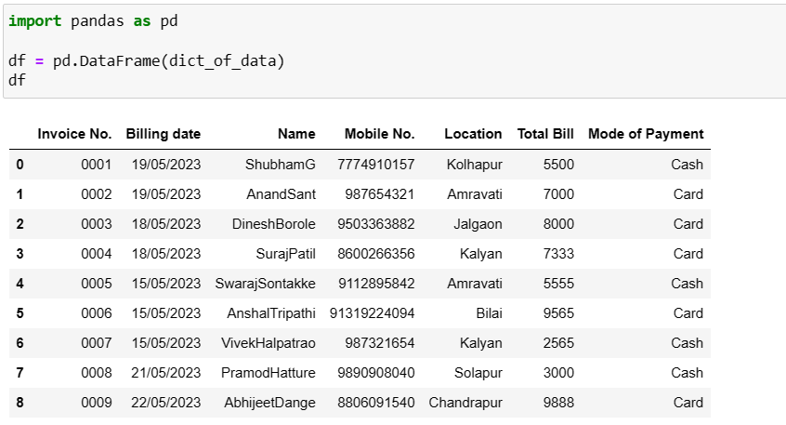
SHOWING DATAFRAME USING PANDAS…

Slide 15
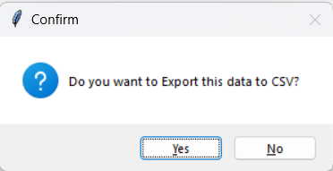
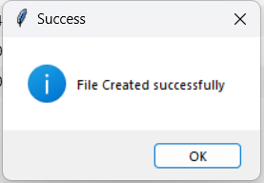
EXPORT DATA TO CSV….
Asking user to export data as CSV by using tkinter liabrary.
If User said YES then file is exported as CSV in given Path and gives message as

Slide 16
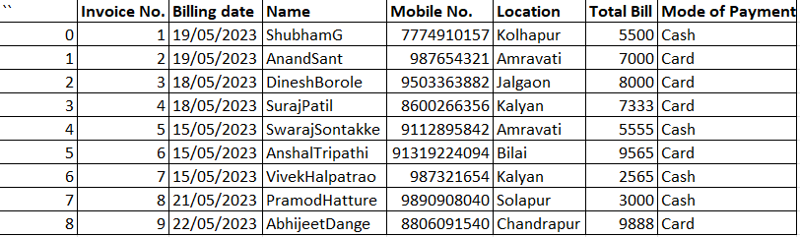
Inside csv file…

Slide 17

Thank You..!

